Slide 1
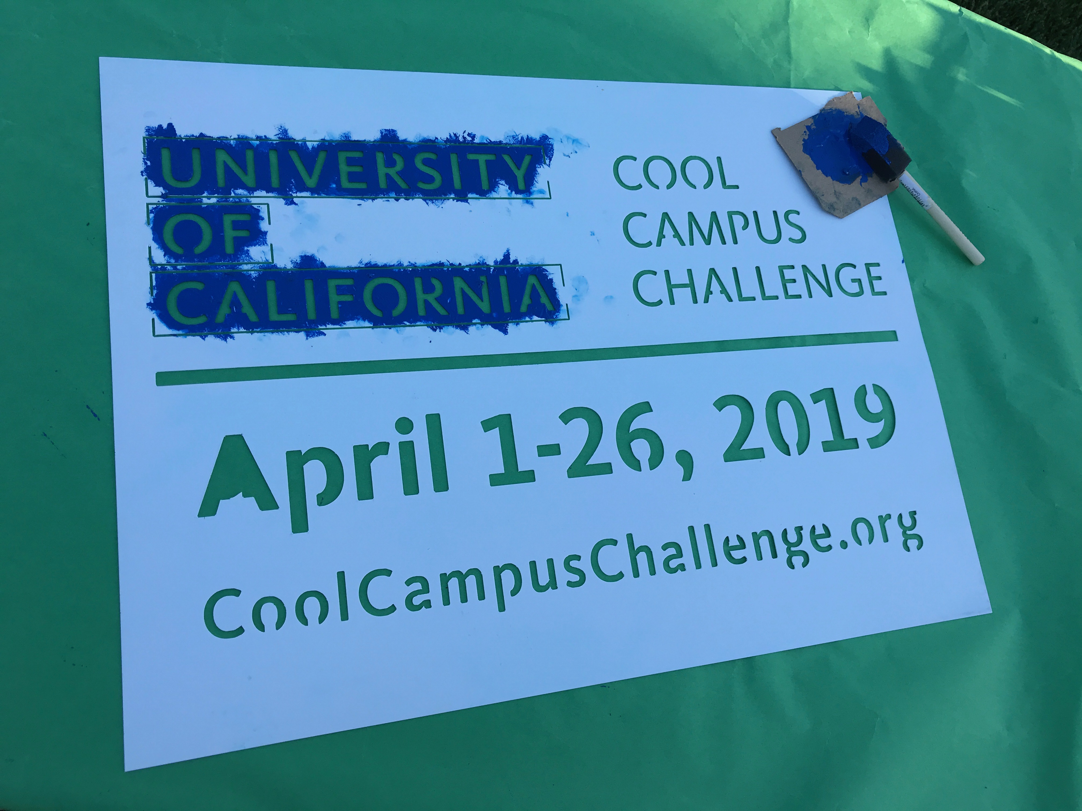
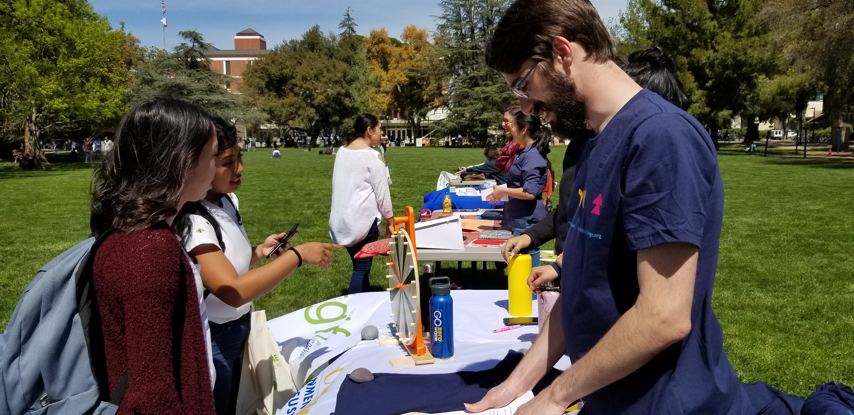
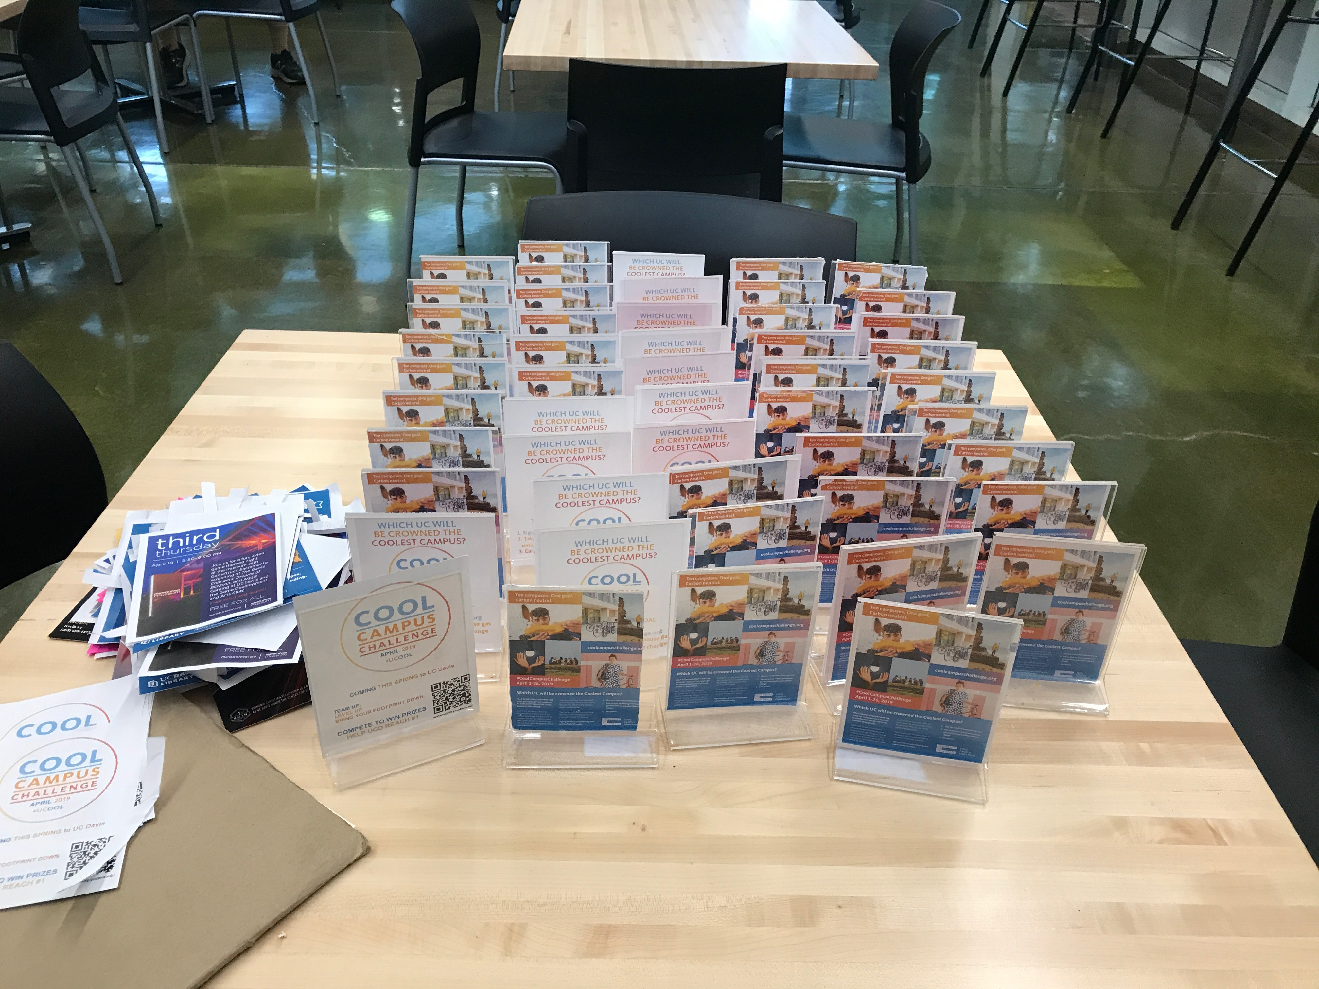
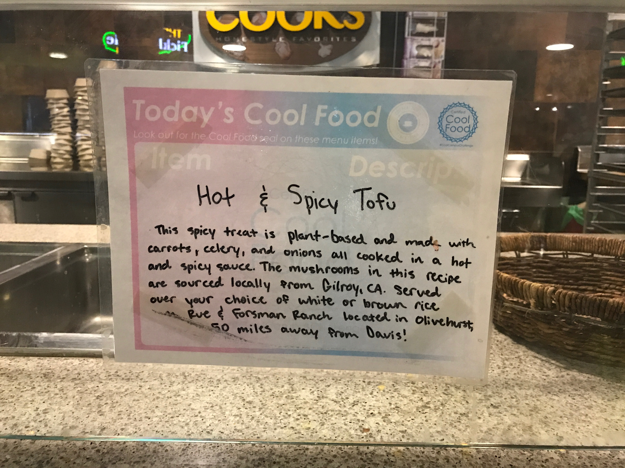
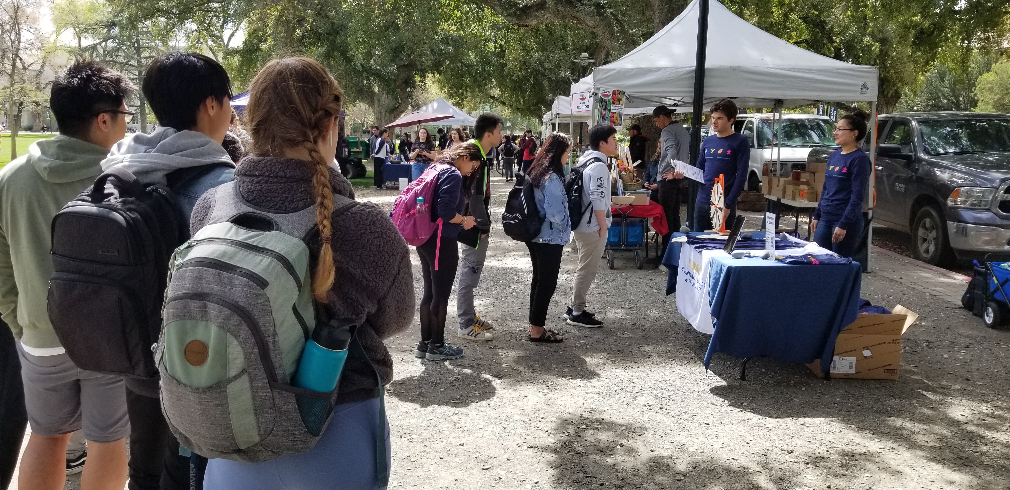
The Cool Campus Challenge at UCD Nick Linda, Sheila Perez, Tyler Barzee and Eileen Hollett
Introduction
Materials and Methods
Conclusions
The Cool Campus Challenge was a friendly competition between the UC campuses, health campuses, and the UC Office of the President to determine which campus could log the most environmentally personal choices made by students, faculty and staff. The Challenge used a website similar to a social media feed as a platform for participants to record their green actions and obtain associated numbers of points. Participants could either compete alone or in teams, with prizes given to the highest scoring individuals and highest scoring teams.
UC Davis CNI Fellows worked on multiple engagement events to encourage students to get involved in the Challenge before and during the event itself. These efforts included tabling, giveaways, and sustainability-themed events such as a tree planting and sustainability sketch crawl.
Campuses were given a budget of $2000 for everything related to the Cool Campus Challenge, plus a separate budget of $2000 for giveaway items produced by UCOP. UC Davis chose to use these funds to purchase:
A sidewalk chalk stencil
Posters and flyers describing the Challenge
Short and long sleeve shirts with Cool Campus Challenge branding
A Prepd Pack lunchbox
To promote the competition, UC Davis Fellows created and carried out several events and engagement efforts including:
Various weekly tabling events on campus
A “Certified Cool Food” badge on the menu of a CoHo food stall
An online campus-wide sustainability scavenger hunt
Various listserve emails
A sustainability-themed campus sketching event
Distributing branded coffee sleeves at campus cafes
Attending a reusable bag customization workshop
A campus tree planting
Events like the CCC are crucial to increasing public awareness of climate change and inspiring individuals to make simple changes in their everyday lives to live sustainably. Although in themselves small, individual actions can cause serious change when many people take them in large enough numbers.
Results and Outcomes
Using the sidewalk chalk stencil for customizing reusable canvas bags at a sustainability event.
As a result of outreach efforts, UC Davis achieved:
About 15,000 individual actions
Prevention of about 1.8 million pounds of CO2 emissions
Over 1500 total UCD student, faculty and staff participants
Ultimately, however, UC Berkeley won the title of “Coolest Campus” with UC Davis finishing in 5th place.
Future Goals
The Cool Campus Challenge may return in the future, and if it does UCD will once again strive for the honor of “Coolest Campus”. Fellows and the Office of Sustainability have given the creators of the Cool Campus Challenge at the UC Office of the President feedback regarding issues experienced with the online tool. Among other things, the hope is that future versions of the Cool Campus Challenge allow users to post videos, contain better safeguards against fraudulent actions, and have a home in a mobile phone application.
Tabling on the UC Davis Quad
Goals
Campuses were given the goal of achieving 3000 signups for the challenge. UC Davis strove for this goal while doing its best to be crowned the “Coolest Campus” by logging the most points.
Table tents at the Coffee House
“Today’s Cool Food” sign at the CoHo’s Cooks stall
Acknowledgements
The efforts of the Cool Campus Challenge would not have been possible without the cooperation of the sustainability team at Student Housing and Dining Services and the ASUCD CoHo. The Office of Sustainability would also like to thank the UC Davis Arboretum for their help in coordinating the campus tree planting and Pete Scully for his wonderful guidance during the Sketching Sustainability Sketch Crawl. Finally, many thanks to the UC Office of the President for funding and supporting our efforts as Fellows.
Tabling at the UC Davis Farmer’s Market
Notes:
Phase II: In-depth assessment (similar to LEEDS) and information exchange with entire research group. Inform staff of support services, shared equipment, onservation impact, altered techniques or materials. Inquire: needs and concerns
Phase III: Follow up

